Slide 1
Final Presentation
Smart Homepany : Customize your workplace
Team 1
김민현 | 김영빈 | 김종헌
오세훈 | 이미소 | 임세창 | 홍권

Slide 2
INDEX
01
Introduction
02
Software Requirement Specification
03
Software Design Specification
04
Effects

Slide 3

01
Introduction

Slide 4




01
Background
Telecommuters
Creators
Freelancers

Slide 5
01
Motivation
Increasing
Home Workers
Problem
Personal &
Flexible Workstyle
Inefficient Work &
Uncomfortable Rest
NO Smart Home
NO System

Slide 6
02
Software Requirement Specification

Slide 7
02
Software Requirements Specification
Purpose & Contents
Purpose
: Find out and document user requirements system requirements
Contents
1 Introduction
2 Overall Description
3 Specific Requirements
4 Supporting Information

Slide 8
02
Overall Description
Contents
1 Product Perspective
2 Product Functions
3 User Classes and Characteristics
4 Operating Environment
5 Design and Implementation Constraints
6 Assumption and Dependencies

Slide 9





02
Overall Description
Product Functions
Search & connect to IoT device
Add, edit, remove presets
Reserve timelines
Customize settings of IoT device

Slide 10
02
Specific Requirements
Contents
1 Externel Interface Requirements
2 Functional Requirements
3 Nonfunctional Requirements
4 Organizing the Specific Requirements
5 System Architecture
6 Assumption and Dependencies

Slide 11






02
External Interface Requirements
Interfaces
User Interfaces
Hardware Interfaces
Software Interfaces
Communication Interfaces

Slide 12
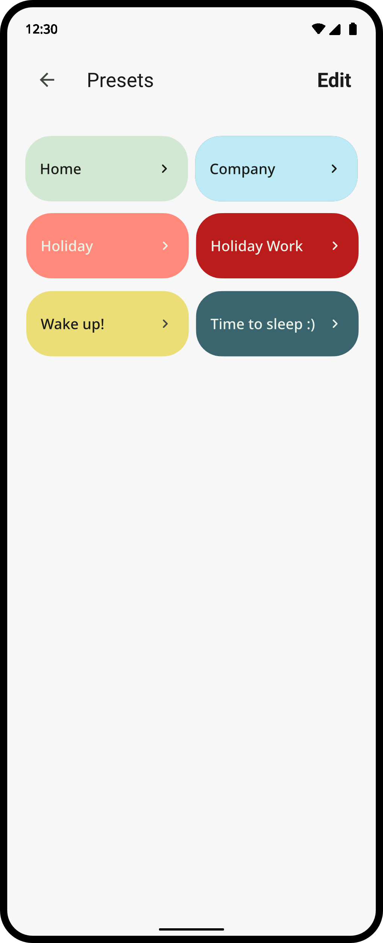
02
External Interface Requirements
User Interface Example
◆ Purpose/Description: It shows the list of basic presets and presets
registered by the user.
◆ Input Source/Output Destination: Server/Client
◆ Range/Accuracy/Margin of Errors: N/A
◆ Unit: Screen
◆ Time/Velocity: N/A
◆ Relationship with other input/output: N/A
◆ Format/Configuration
1. Layout shows the preset list.
2. User can move detail page of each preset by clicking preset.
3. User can move edit page by clicking edit button.
◆ Data Type: Text, Image, Widget, Button
◆ Instruction Type: N/A
◆ Exit Message: N/A

Slide 13
02
Functional Requirements
Use Cases
01 Updating the latest firmwares of connected IoT devices
02 Updating the latest Smart Hompany software
03 Searching IoT devices
…
11 Editing preset reservation
12 Deleting preset reservation
13 Deactivating preset reservation
Actor
Description
Precondition
Postcondition
Normal Course

Slide 14
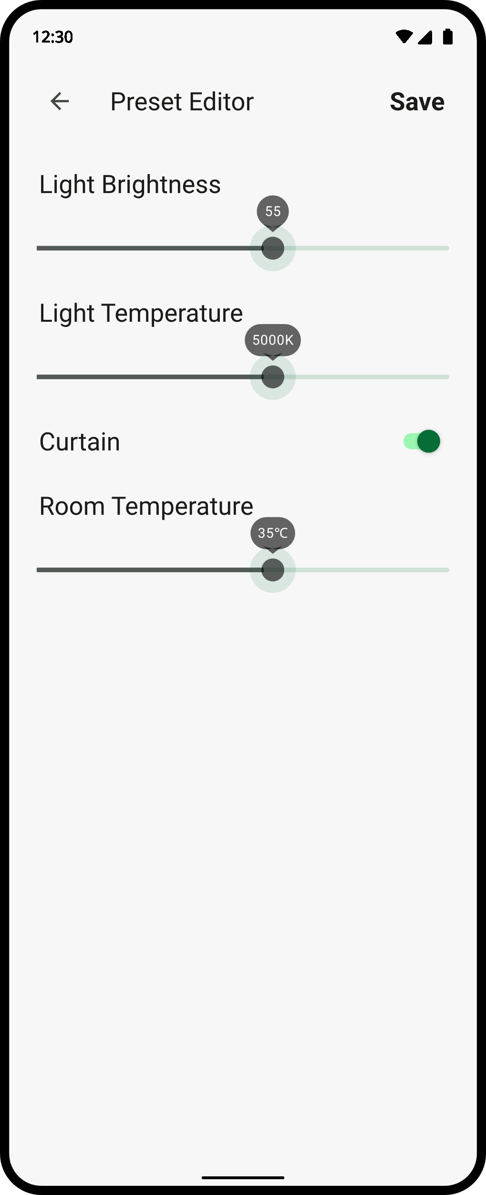
02
Functional Requirements
Use Case Example: Adding Preset
◆ Actor: User, Connected IoT devices, DB
◆ Description: User adds new preset.
◆ Precondition
1. Expected IoT devices should be connect to the same network
as the mobile device.
2. Expected IoT devices should be registered in the system.
3. User clicks the presets button.
◆ Postcondition
1. The list of presets is updated.
2. New preset is added to Preset entity table in DB.
◆ Normal Course
1. System shows the list of presets.
2. User executes edit preset mode by clicking Edit button.
3. User executes add preset mode by clicking Add button.
…
10. DB saves the information by adding new row to Preset entity
table.

Slide 15
02
Nonfunctional Requirements
Contents
1 Product Requirements
Perforamnce Requirements
Space Requirements
Security Requirements
Usability Requirements
Dependability Requirements
2 Organizational Requirements
Environmental Requirements
Operational Requirements
Development Requirements
3 External Requirements
Regulatory Requirements
Ethical Requirements
Accounting Requirements
Safety/Security Requirements

Slide 16
02
Nonfunctional Requirements
Examples
EXAMPLE 1 Product Requirements
…
The software should transmit the signal from mobile device to each IoT devices under a second.
…
EXAMPLE 2 Organizational Requirements
…
To use the software, there should be at least one connectable IoT device in user’s home.
…
EXAMPLE 3 Externel Requirements
…
The software should not be used with malicious intention by connecting and controlling others’ IoT devices.
…

Slide 17
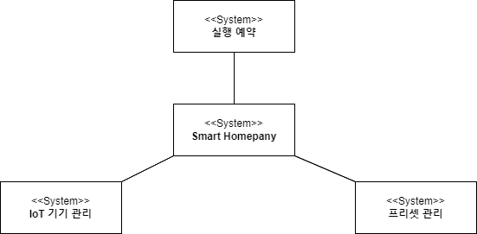
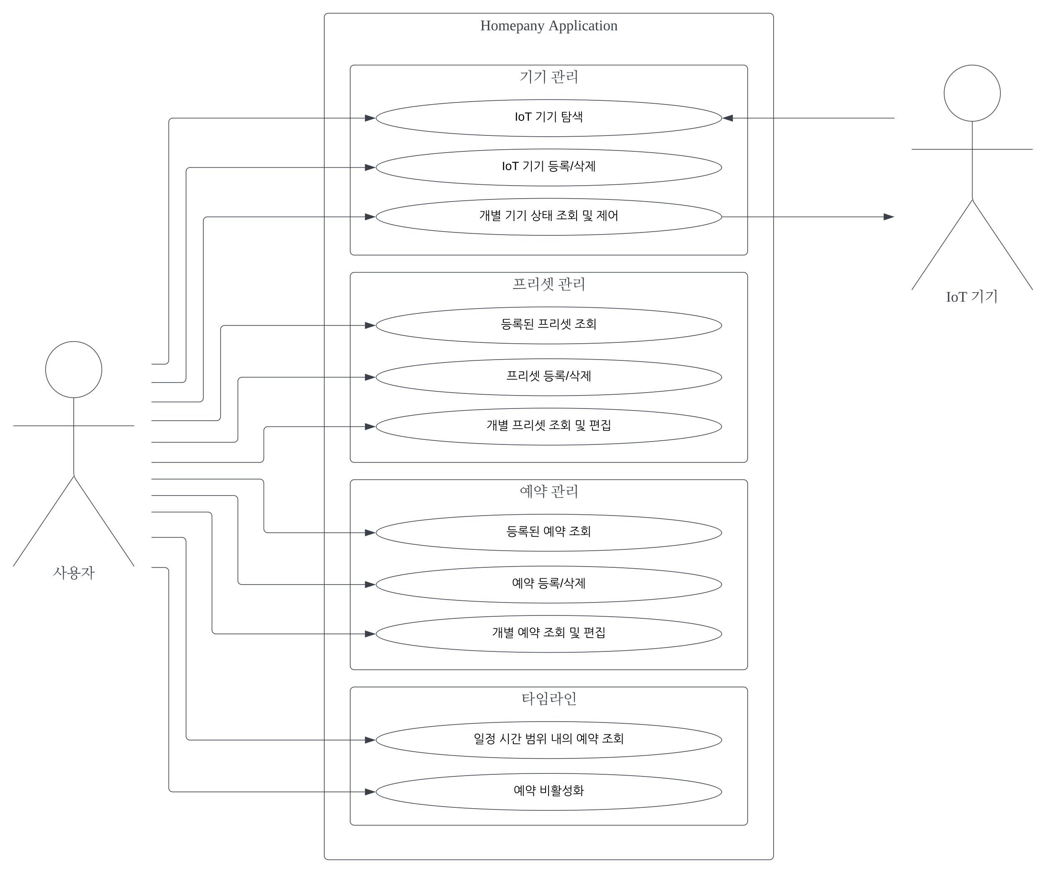
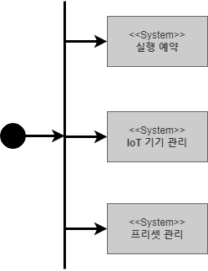
02
Organizing the Specific Requirements
Models & Diagrams
1 Context Model
3 Interaction Model
2 Process Model

Slide 18
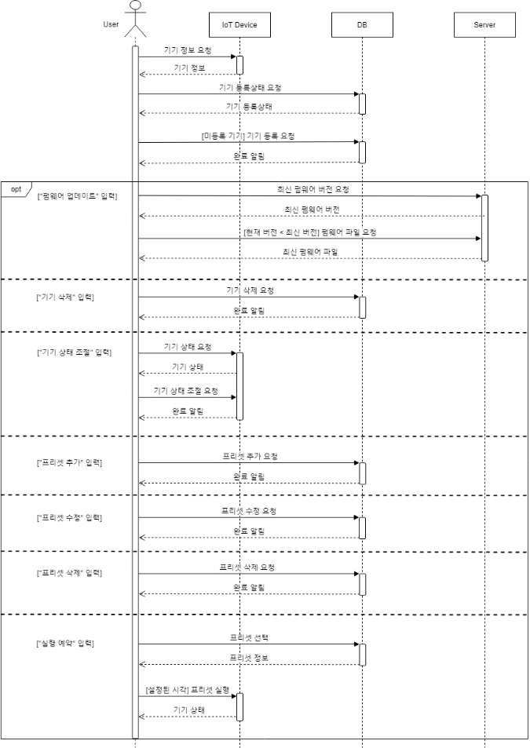
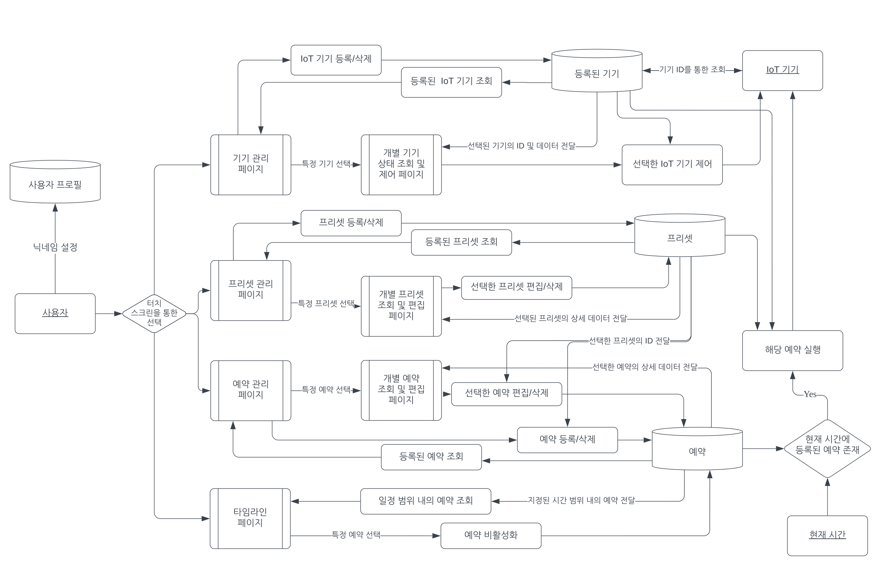
02
Organizing the Specific Requirements
Models & Diagrams
4 Behavior Model
5 System Architecture
6 System Evolution

Slide 19
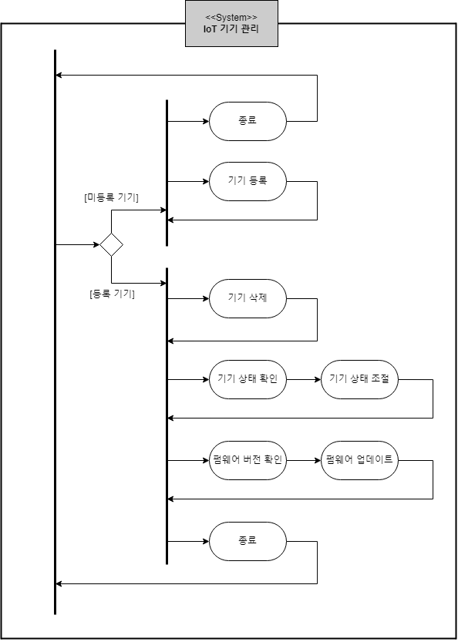
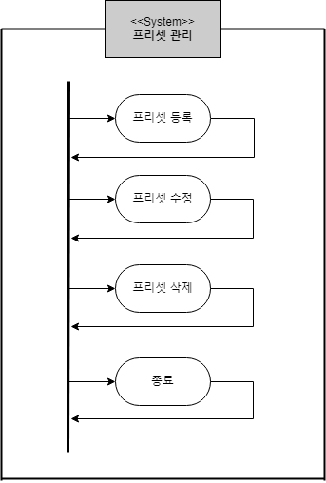
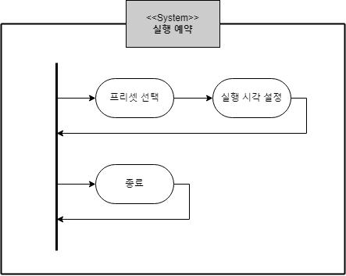
02
Organizing the Specific Requirements
Process Model

Slide 20
03
Software Design Specification
Notes:
.

Slide 21
03
Software Design Specification
Purpose & Contents
Purpose
: design a system organization which satisfy the functional and non-functional requirements of a system.
Contents
01 Preface
02 Introduction
03 System Architecture - Overall
04 System Architecture – Frontend
05 System Architecture – Backend
06 Protocol Design
07 Database Design
08 Testing Plan
09 Development Plan
10 Supporting Information

Slide 22
03
System Architecture: Frontend
Objective & Subcomponents
Objectives
: explain components of the system architecture with class diagram and sequence diagram
Subcomponents
Profile
MainPage
Manage
Device
Device
Detail
PresetPage
PresetDetail
Page
NewPreset
Page
Timeline
Page
Timeline
DetailPage
NewTimelinePage

Slide 23
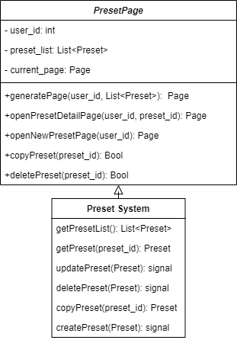
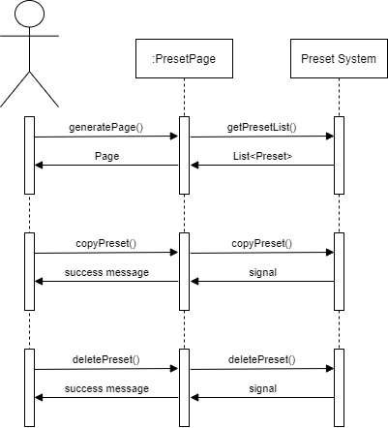
03
System Architecture: Frontend
Subcomponent Example: PresetPage
Class Diagram
Sequence Diagram

Slide 24
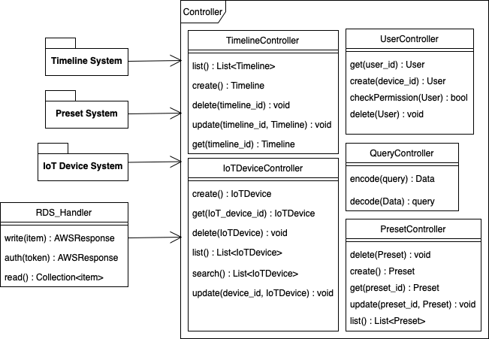
03
System Architecture: Backend
Objective & Overall Architecture
Objectives
: explain the overall backend system and components of the system architecture with class diagram and sequence diagram

Slide 25
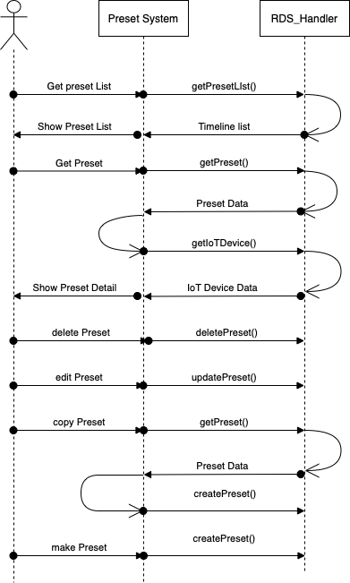
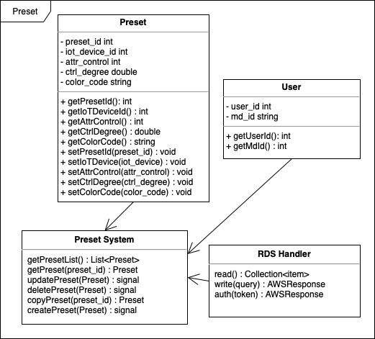
03
System Architecture: Backend
Subcomponent Example: Preset System
Class Diagram
Sequence Diagram

Slide 26



03
Protocol Design
Objectives & Contents
Objectives
: explain how server, DB, and software communicate with each other
Contents
Transfer Protocol
Data Type
REST

Slide 27
03
Protocol Design
Example: Load Preset List
◆ Function: Load the preset list of user
◆ URL: {{url}}/preset/list
◆ METHOD: GET
◆ Parameter: user_id(string)
◆ Success Return
ResultCode: 200(HTTP status code)
PresetList: preset list of user(list)
◆ Failed Return
ResultCode: 400(HTTP status code)
◆ Type of Error
Failed user authentication – ResultCode: 400
{
"ResultCode":200,
"PresetList":[
{
"preset_id":1,
"iot_id":”E06C3823FC827F63C3”,
"attr_control":2,
"ctrl_degree":3.0,
"color_code":"0xffffff"
},
{
"preset_id":2,
"iot_id":”E06C3823FC827F63E3”,
"attr_control":33,
"ctrl_degree":133.0,
"color_code":"0xfecd2f"
}
]
}
Example of JSON when return successfully

Slide 28
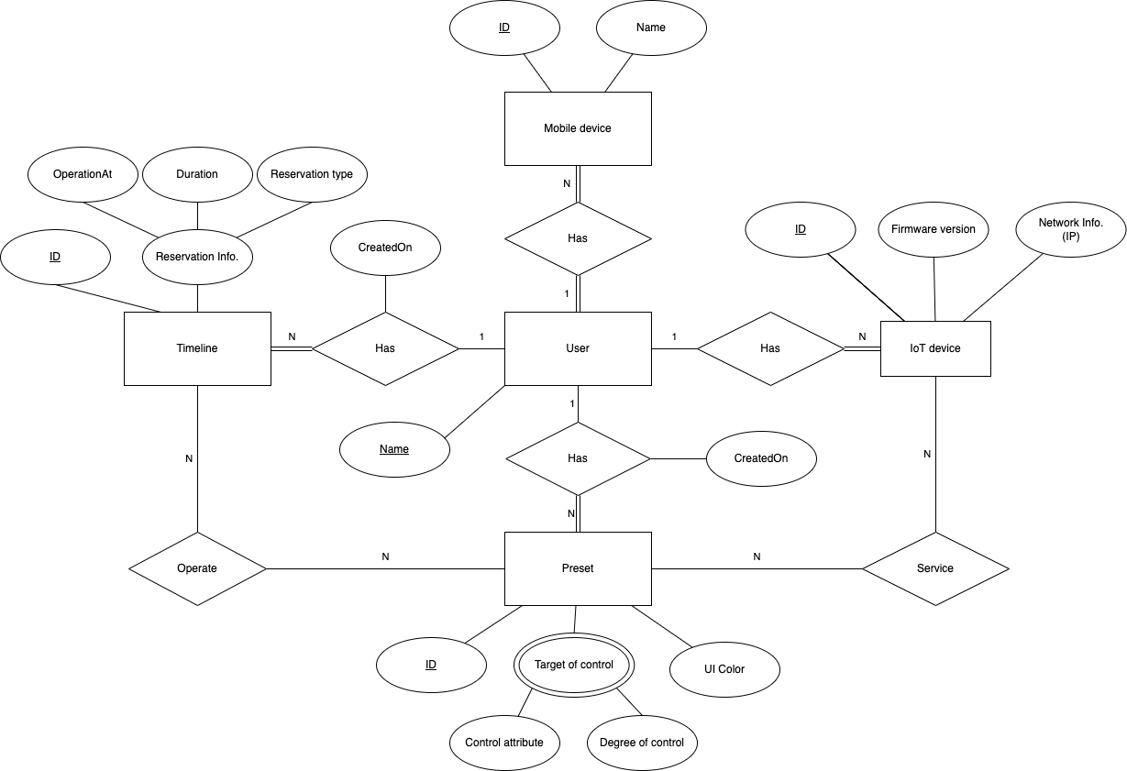
03
Database Design
Objectives & ER Diagram
Objectives
: explain components of the system architecture with class diagram and sequence diagram
ER Diagram

Slide 29
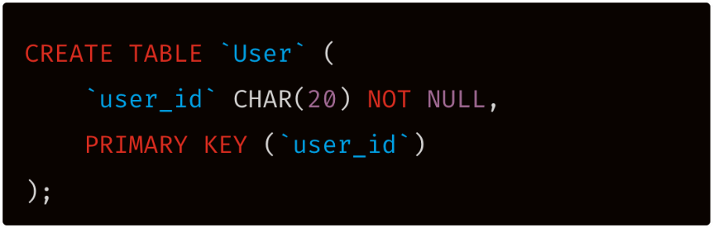
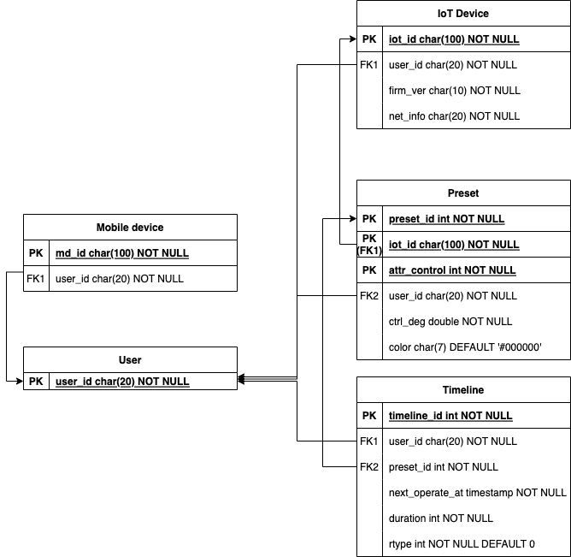
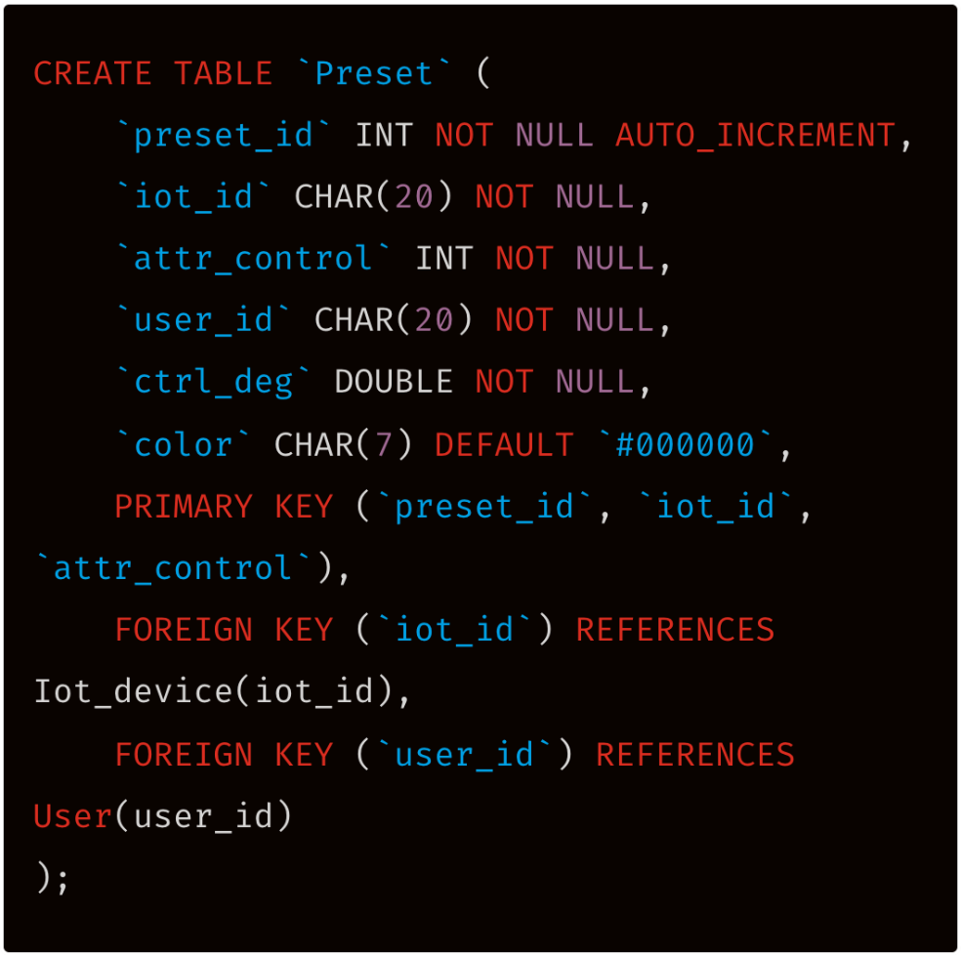
03
Database Design
Realtaional Schema & SQL DDL Example
Relational Schema
SQL DDL

Slide 30
03
Testing Plan
Objectives
Objectives
: explain the plan of implementation, distribution and user test
Contents
01 Development Test
02 Release Test
03 User Test
04 Test Case

Slide 31







03
Development Plan
Environments
Front-end
Back-end
Server
Database

Slide 32
04
EFFECTS

Slide 33
03
Effects
Mode Change
Separate your
home and workplace perfectly
Customize your
own mode
Automatic
execution
High
usability

Slide 34
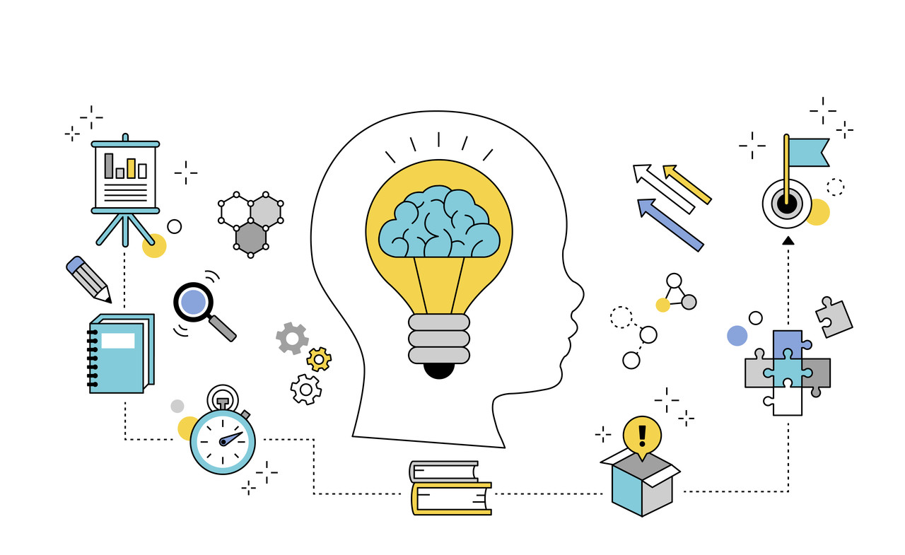
03
Effects
Relieving compulsion to stay on-line all the time
Increasing work efficiency and concentration
Improving quality of life

Slide 35
THANK YOU

